Slide 1

A LSTM with Dual-stage Attention Method to Predict Amine Emissions for Carbon Dioxide Capture and Storage
IEEE BIG DATA 2024 WORKSHOP on Dec 17th
University of Maryland Baltimore County and Raytum Photonics
Authors: Sai Rajesh Rapelli, Dr. Zhiyuan Chen, Dr. Wei Lu
Notes:
Opening: "Hello, everyone. My name is Sai Rajesh Rapelli, and today, I'll present our research titled ‘A LSTM with Dual-stage Attention Method to Predict Amine Emissions for Carbon Dioxide Capture and Storage.’"
Introduce collaborators: "This work was conducted in collaboration with Dr. Zhiyuan Chen and Dr. Wei Lu, representing the University of Maryland Baltimore County and Raytum Photonics."
Conference: "We’re excited to share this at the IEEE Big Data 2024 Workshop."
Slide 2: Introduction
Context: "Carbon dioxide capture is a critical component in combating climate change. Industrial facilities are key sources of CO2 emissions, and effective capture strategies can significantly mitigate their impact."
Goal: "Our objective is to enhance amine emission predictions using advanced machine learning models, particularly a Long Short-Term Memory (LSTM) autoencoder with a dual-stage attention mechanism."
Significance: "Improved prediction accuracy supports better operational strategies in carbon capture systems."
Slide 3: Carbon Capture Process
Diagram explanation: "This diagram shows the process of carbon dioxide capture. The flue gas undergoes preparation to remove contaminants and is then directed to the absorber where CO2 interacts with a solvent for capture."
Key components: "The washing section prevents environmental contamination, while the pure CO2 collected at the stripper's summit is prepared for storage or reuse."
Focus: "Our research focuses on predicting solvent emissions during this process."
Slide 4: Related Work
Literature review: "Various approaches, such as gradient-boosted decision trees and CNNs, have been explored for predicting amine emissions. However, these models often lack the capability to handle time-series dependencies effectively."
LSTM advancements: "LSTM, combined with attention mechanisms, has shown superior results in domains like stock price forecasting and earthquake prediction. Inspired by these studies, we applied a dual-stage attention-enhanced LSTM autoencoder to this problem."
Slide 5: Methodology
Data source: "We used real-world data from the Technology Center Mongstad. The dataset includes 31 plant parameters and four amine emission measures."
Feature selection: "Key features were chosen based on Pearson correlation to ensure relevance and accuracy."
Data transformation: "We processed the data into time series with a window size of 25, capturing essential temporal dependencies for prediction."
Slide 6: Proposed Model Architecture
Model explanation: "This is our proposed LSTM autoencoder with dual-stage attention. It includes two attention layers, one before the encoder to emphasize input features and another between the encoder and decoder for embedding features."
Advantage: "This architecture ensures the model learns both short- and long-term dependencies, improving prediction accuracy."
Slide 7: Experiment Setup
Configuration: "We compared multiple models, including LSTM, CNN, and gradient boosting trees, to predict AMP and Piperazine emissions."
Implementation: "All models were implemented using TensorFlow and Keras. Training was conducted on Google Colab, with a total training time of less than 30 minutes for 900 epochs."
Slide 8: Results - AMP Prediction
Performance analysis: "The dual-stage attention model outperformed all other methods, achieving an error rate of 6.8% with six selected features. The attention layers enhanced focus on critical features, resulting in more accurate predictions."
Graph interpretation: "As seen in the graph, other models, such as CNN and gradient boosting, had higher error rates due to their inability to handle time-series dependencies effectively."
Slide 9: Results - Piperazine Prediction
Piperazine results: "Similar trends were observed for Piperazine predictions, with the dual-stage attention model again outperforming the others. The lowest error rate achieved was 5.8%."
Comparison: "These results highlight the robustness and adaptability of our model across different amine types."
Slide 10: Visual Results
Graphs: "These graphs compare predicted and actual values for AMP and Piperazine emissions. The closeness of the red (predicted) and blue (actual) lines demonstrates the accuracy of our model."
Highlight: "The model successfully captures fluctuations and patterns in emission levels, aligning closely with real data."
Slide 11: Conclusion
Key findings: "Our LSTM autoencoder with dual-stage attention demonstrates strong performance in predicting amine emissions, with error rates between 5.8% and 6.8%. It significantly outperforms existing methods, proving its potential for real-time monitoring applications."
Broader implications: "This model can enhance operational strategies, ensuring more effective and sustainable carbon capture."
Slide 12: Future Work
Next steps: "We plan to integrate transfer learning to adapt the model for other carbon capture facilities, broadening its applicability."
Vision: "This will enable predictive robustness across diverse environmental settings, further advancing emission control technologies."
Slide 13: Thank You
Closing: "Thank you for your attention. I look forward to your questions and feedback on our work."

Slide 2
INTRODUCTION
Carbon Dioxide Capture is crucial for mitigating climate change.
Proposed an approach using machine learning models to enhance amine emission predictions.
We aim to improve accuracy and efficiency in predicting emissions, contributing to more effective carbon capture strategies.
Notes:
Slide 2: Introduction
Context: "Carbon dioxide capture is a critical component in combating climate change. Industrial facilities are key sources of CO2 emissions, and effective capture strategies can significantly mitigate their impact."
Goal: "Our objective is to enhance amine emission predictions using advanced machine learning models, particularly a Long Short-Term Memory (LSTM) autoencoder with a dual-stage attention mechanism."
Significance: "Improved prediction accuracy supports better operational strategies in carbon capture systems."

Slide 3
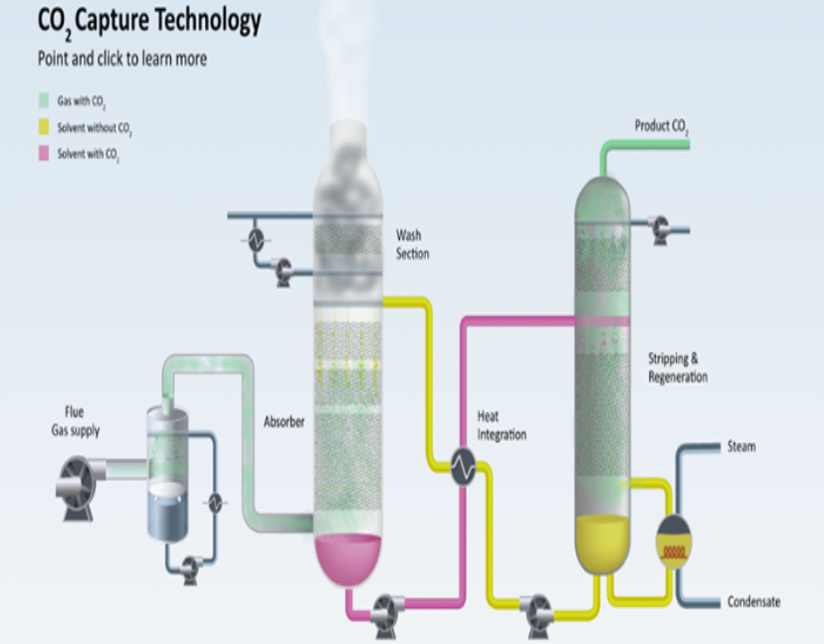
INTRODUCTION
Flue gas undergoes initial preparation through cooling and contaminant removal via water circulation.
Refined flue gas containing CO2 enters the absorber where it moves upward, interacting with the solvent for capture.
A washing section at the absorber's top prevents environmental pollution from the capture process.
Pure CO2 is collected at the stripper's summit and prepared for transportation, storage, or utilization.
The regenerated solvent is recycled back to the absorber for continuous CO2 capture operation
We want to predict solvent emission
Notes:
Diagram explanation: "This diagram shows the process of carbon dioxide capture. The flue gas undergoes preparation to remove contaminants and is then directed to the absorber where CO2 interacts with a solvent for capture."
Key components: "The washing section prevents environmental contamination, while the pure CO2 collected at the stripper's summit is prepared for storage or reuse."
Focus: "Our research focuses on predicting solvent emissions during this process."
Transition: "Let’s first understand the carbon capture process."
Slide 3: Carbon Capture Process
Process Overview: "Flue gas undergoes cooling and contaminant removal before CO2 is captured using amine solvents in an absorber."
Details: "The process includes a washing section to minimize pollutant escape, and the solvent is regenerated and reused."
Why Prediction Matters: "Predicting solvent emissions helps in optimizing this process and minimizing environmental impact."

Slide 4
RELATED WORK
Jablonka et. al. treated the problem of predicting amine emission as a time series prediction problem and used gradient-boosted decision tree and Convolutional Neural Network (CNN).
LSTM and LSTM autoencoders have been widely used for time series prediction: capture both short and long term data dependencies
Several studies across domains combine LSTM with attention mechanisms to improve time series forecasting - notable applications include earthquake prediction (Banna et al.) and stock price forecasting (Li et al.)
The dual-stage attention mechanism allows models to focus on both important input features and embeddings, leading to enhanced prediction results.
Multiple comparative studies (e.g., Abbasimehr and Paki) have demonstrated that attention-enhanced LSTM models consistently outperform traditional time series forecasting methods
We adopt a LSTM autoencoder with dual stage attention.
Notes:
Slide 4: Related Work Previous studies have explored various machine learning approaches for predicting amine emissions
Prior Research: "Studies like those by Jablonka et al. used gradient-boosted trees and CNNs for emission prediction but lacked time-series-specific capabilities."
LSTM Advances: "Attention mechanisms improve LSTM-based time series models in areas like earthquake prediction (Banna et al.) and stock forecasting (Li et al.)."
Our Contribution: "We integrate dual-stage attention with LSTM autoencoders for enhanced accuracy."

Slide 5
METHODOLOGY
Data Preprocessing
We used data from the Technology Center Mongstad. This dataset contains data from a test campaign conducted between November 1, 2020, and November 15, 2020.
We selected a varying number of features using Pearson correlation.
In the pre-processing step, we converted the data into a time series using a window
size of 25.
Finally, we compared the performance of various models to predict AMP emission with 4, 6, 8, and 10 features.
Notes:
Dataset: "We used data from the Technology Center Mongstad, focusing on AMP and Piperazine emissions. Features were selected using Pearson correlation."Preprocessing: "Time series conversion with a window size of 25 allowed us to model dependencies effectively."Transition: "Now, let’s explore the architecture we designed."

Slide 6
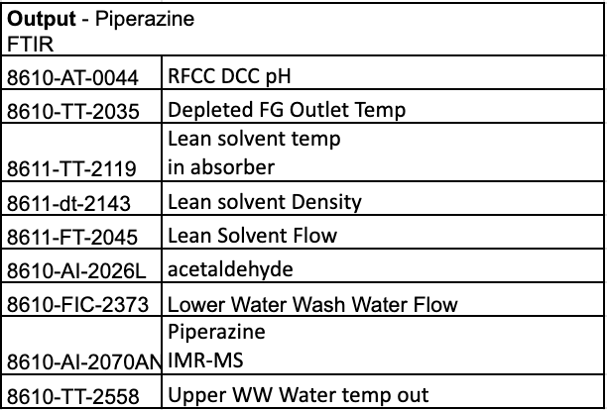
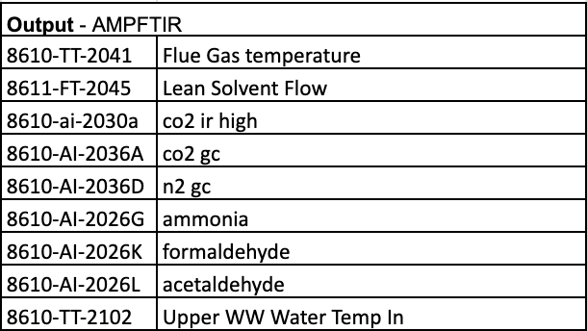
METHODOLOGY
Selected features

Slide 7
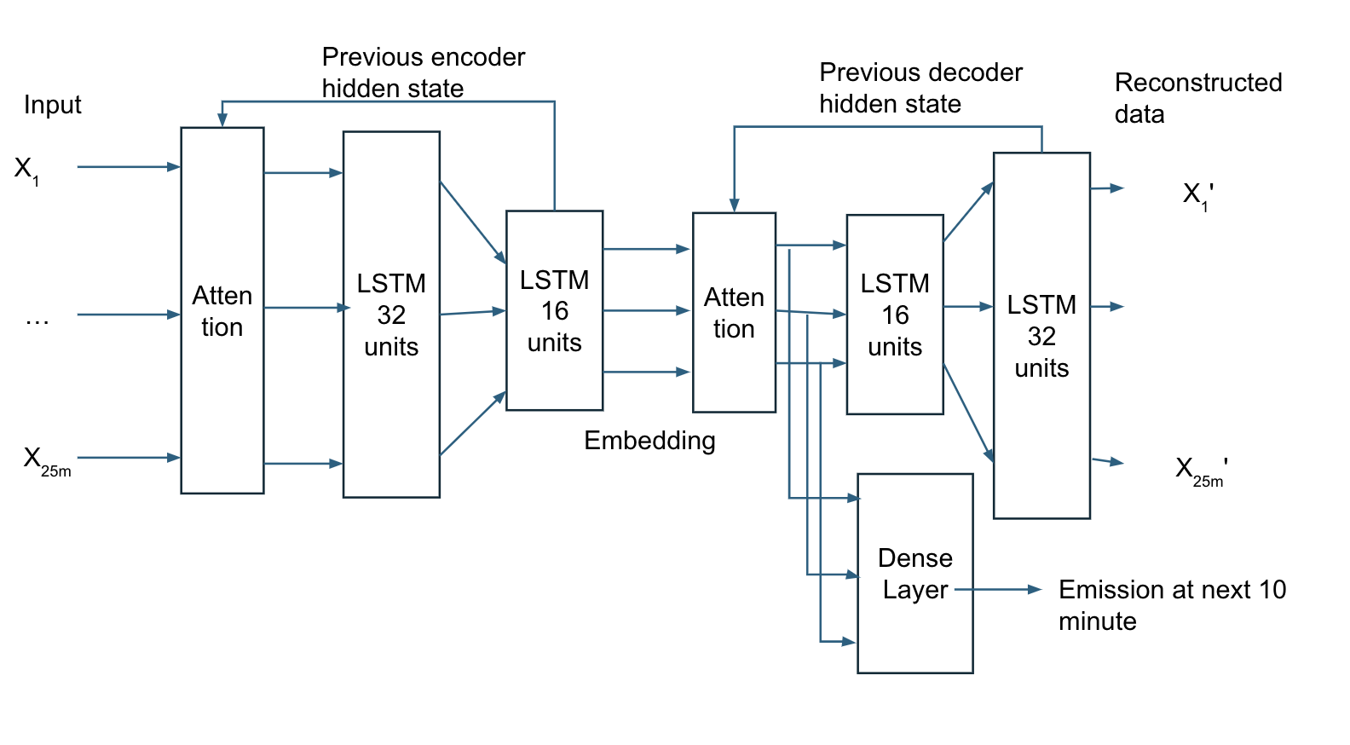
PROPOSED MODEL ARCHITECTURE
Autoencoder compresses complex time-series data into a lower-dimensional representation, effectively capturing essential patterns.
Dual attention analyse by focusing on input elements before the encoder and embedding features before the decoder, improving prediction performance.
Notes:
This diagram illustrates the architecture of our proposed model, which is based on an LSTM autoencoder with dual-stage attention layers:
Input Layer: On the left, we see the input time-series data X1,X2,...,X25mX_1, X_2, ..., X_{25m}X1​,X2​,...,X25m​, representing 25-minute data windows.
Attention Mechanism: The first attention layer processes the input, allowing the model to focus on the most relevant parts of the sequence.
Encoder: The encoder consists of two LSTM layers with 32 and 16 units, which compress the input into a lower-dimensional embedding that captures essential patterns.
Second Attention Layer: Positioned after the embedding, this layer highlights the most significant features from the encoded representation.
Decoder: The decoder mirrors the encoder with two LSTM layers, reconstructing the input sequence while generating predictions.
Dense Layer: A dense layer takes the processed features and predicts the emission levels for the next 10 minutes.
Outputs: The reconstructed input data X1′,X2′,...,X25m′X_1', X_2', ..., X_{25m}'X1′​,X2′​,...,X25m′​ and the emission prediction provide both the model’s reconstruction accuracy and its forecasting capability.
The dual-attention layers improve focus during encoding and decoding, leading to more accurate predictions and efficient feature utilization."

Slide 8
EXPERIMENT SETUP: ML Methods
LSTM: We used two LSTM layers with 32 and 16 LSTM units each, and a dense layer for prediction.
LSTM autoencoder: The encoder also consists of two LSTM layers with 32 and 16 LSTM units each, the decoder has the same two layers but in reverse order ,and a dense layer taking encoder output as input for prediction.
Autoencoder with a single attention layer: This is a variant where we only add an attention layer between encoder and decoder.
Notes:
Slide 1: EXPERIMENT SETUP: ML Methods
This slide introduces the machine learning models used in your experiment. Here's how to describe each method in detail:
1. LSTM (Long Short-Term Memory)
What is it? LSTM is a type of recurrent neural network (RNN) designed to model sequences of data by capturing long-term dependencies.
Architecture in this experiment:
Your LSTM model consists of two layers:
The first LSTM layer has 32 units (neurons).
The second layer has 16 units.
The output of the LSTM is passed to a Dense (fully connected) layer, which makes the final predictions.
Why LSTM?
It’s effective for time-series data or any sequential input.
It handles issues like vanishing gradients, which traditional RNNs struggle with, allowing better learning of patterns over long sequences.
2. LSTM Autoencoder
What is it? An autoencoder is a type of neural network that aims to compress (encode) the input into a smaller representation and then reconstruct (decode) the original input.
Structure:
Encoder:
Two LSTM layers (32 units followed by 16 units).
Encodes input sequences into a compact, lower-dimensional representation.
Decoder:
Two LSTM layers (mirroring the encoder, with 16 and 32 units).
Reconstructs the original input sequence from the encoded representation.
Finally, a Dense layer predicts the output from the reconstructed representation.
Why use an autoencoder?
It’s ideal for capturing latent (hidden) patterns in the data.
Autoencoders are often used in dimensionality reduction and feature extraction tasks, making them useful for reconstruction-based learning.
3. Autoencoder with a Single Attention Layer
What’s different here? This model builds on the LSTM autoencoder but incorporates an attention mechanism between the encoder and decoder.
How does attention work?
Attention allows the model to focus on important parts of the input sequence rather than treating all parts equally.
This helps improve the relevance of the reconstruction and downstream predictions.
Purpose of attention:
It addresses limitations of traditional LSTMs, which may struggle to identify critical patterns over long sequences.
This model improves performance by enabling the network to assign higher weights to key features.

Slide 9
EXPERIMENTS
Autoencoder with dual-stage attention: This is the proposed method, with LSTM autoencoder as described above and two attention layers, one as the first layer before encoder, and the other in between the encoder and decoder.
Gradient boosting tree: Type of machine learning algorithm used for both regression and classification problems.
Convolutional neural network (CNN): To make a fair comparison, we used two layers of CNN with 32 and 16 units in each layer followed by a dense layer for prediction.
Notes:
4. Autoencoder with Dual-Stage Attention (Proposed Model)
What’s new? This model introduces two attention layers to improve feature extraction:
Attention before the encoder: Focuses on enhancing the input features by prioritizing relevant patterns before compression.
Attention between encoder and decoder: Helps the decoder reconstruct the output more effectively by focusing on the most important encoded features.
Why is this innovative?
The dual-stage attention mechanism allows for better information flow throughout the model.
It enhances the model’s ability to learn complex patterns, particularly in data where certain features carry more significance than others.
5. Gradient Boosting Tree (Baseline Model)
What is it? Gradient Boosting is a traditional machine learning algorithm that builds multiple decision trees sequentially, improving accuracy at each step by minimizing errors of the previous trees.
Why include this?
It serves as a baseline to compare the performance of advanced neural networks.
It’s widely used for both regression and classification tasks, making it a practical benchmark for your experiment.
6. Convolutional Neural Network (CNN)
What is it? CNNs are commonly used in image and sequence data tasks. They are excellent at learning spatial or hierarchical patterns.
Architecture in this experiment:
The CNN has two convolutional layers:
The first layer has 32 units.
The second layer has 16 units.
The convolutional layers are followed by a Dense layer for final predictions.
Why include CNN?
It allows you to compare the performance of sequence models like LSTMs and autoencoders with a spatial feature extraction approach.
Although CNNs are not specifically designed for sequential data, their adaptability to various tasks makes them a useful comparison.

Slide 10
EXPERIMENTS SETUP
We trained two models separately for each machine learning method: one to predict AMP emission and the other to predict Piperazine emission.
Using 80% of the data for training and the remaining 20% for testing.
All models were implemented using Tensorflow
2.17.0 and Keras 3.4.1 with 900 training epochs.
The total number of parameters are 34033
Training time: < 30 minutes
Notes:
Slide 7: Experiment Setup
Model Comparisons: "We compared standard LSTM, autoencoders, and CNNs, training models to predict AMP and Piperazine emissions."
Technical Details: "Models were trained using TensorFlow and Keras for 900 epochs, with 80% training and 20% testing data split."
Efficiency: "Training took under 30 minutes, making this approach computationally feasible."

Slide 11
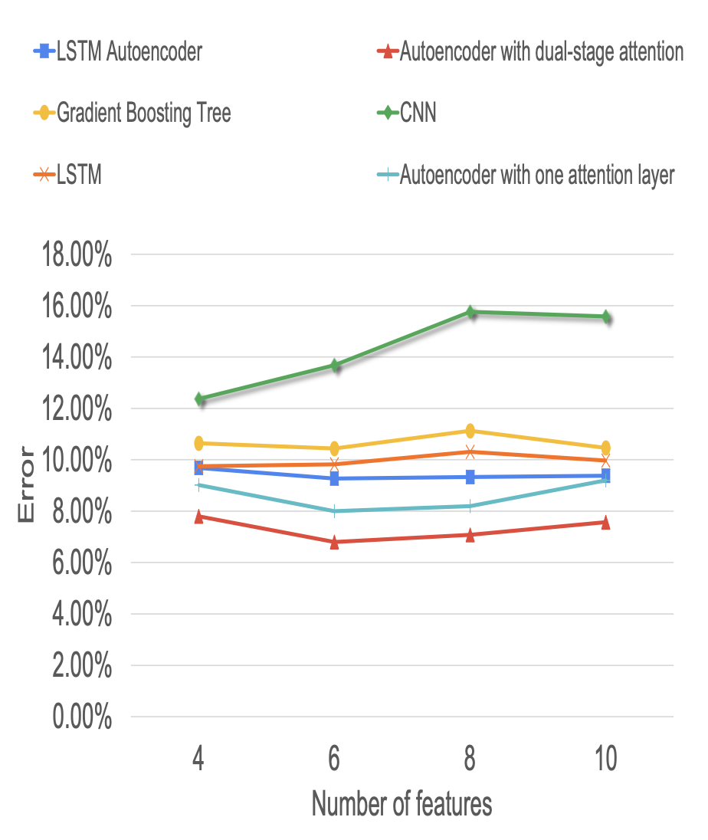
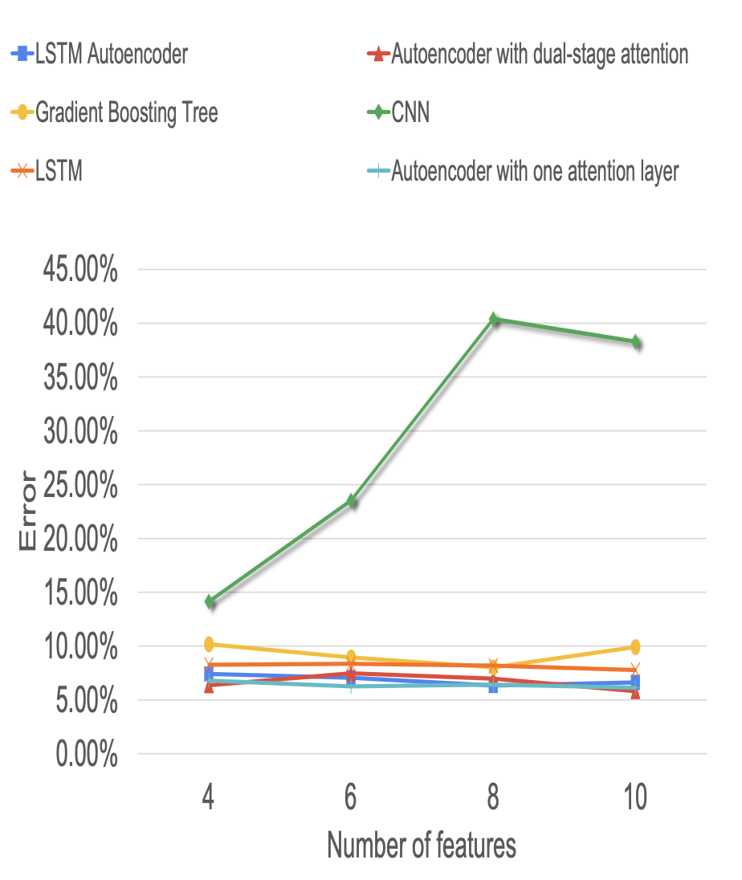
RESULTS
Prediction of AMP with different models
Prediction of Piperazine with different models
Notes:
Left Chart: Prediction of AMP with Different Models
X-axis: Number of features used (4, 6, 8, 10).
Y-axis: Error percentage for AMP prediction.
Key Insights:
The Autoencoder with dual-stage attention (red line) consistently performs the best, achieving the lowest error rate across all feature counts.
Models with attention mechanisms (red and light blue) generally outperform the others, showing the importance of capturing feature importance.
The CNN (green line) has the highest error, indicating its limitations for this task.
Traditional methods like Gradient Boosting Tree (yellow) are slightly less accurate than advanced deep-learning models.
Right Chart: Prediction of Piperazine with Different Models
X-axis: Number of features used (4, 6, 8, 10).
Y-axis: Error percentage for Piperazine prediction.
Key Insights:
The Autoencoder with dual-stage attention (red) again has the lowest error, demonstrating its superior predictive power.
The CNN (green) error rate increases drastically with more features, highlighting its inefficiency in this task.
Other models like the LSTM Autoencoder (blue) and Gradient Boosting Tree (yellow) show moderate error rates, but the attention-enhanced models are clearly better.

Slide 12
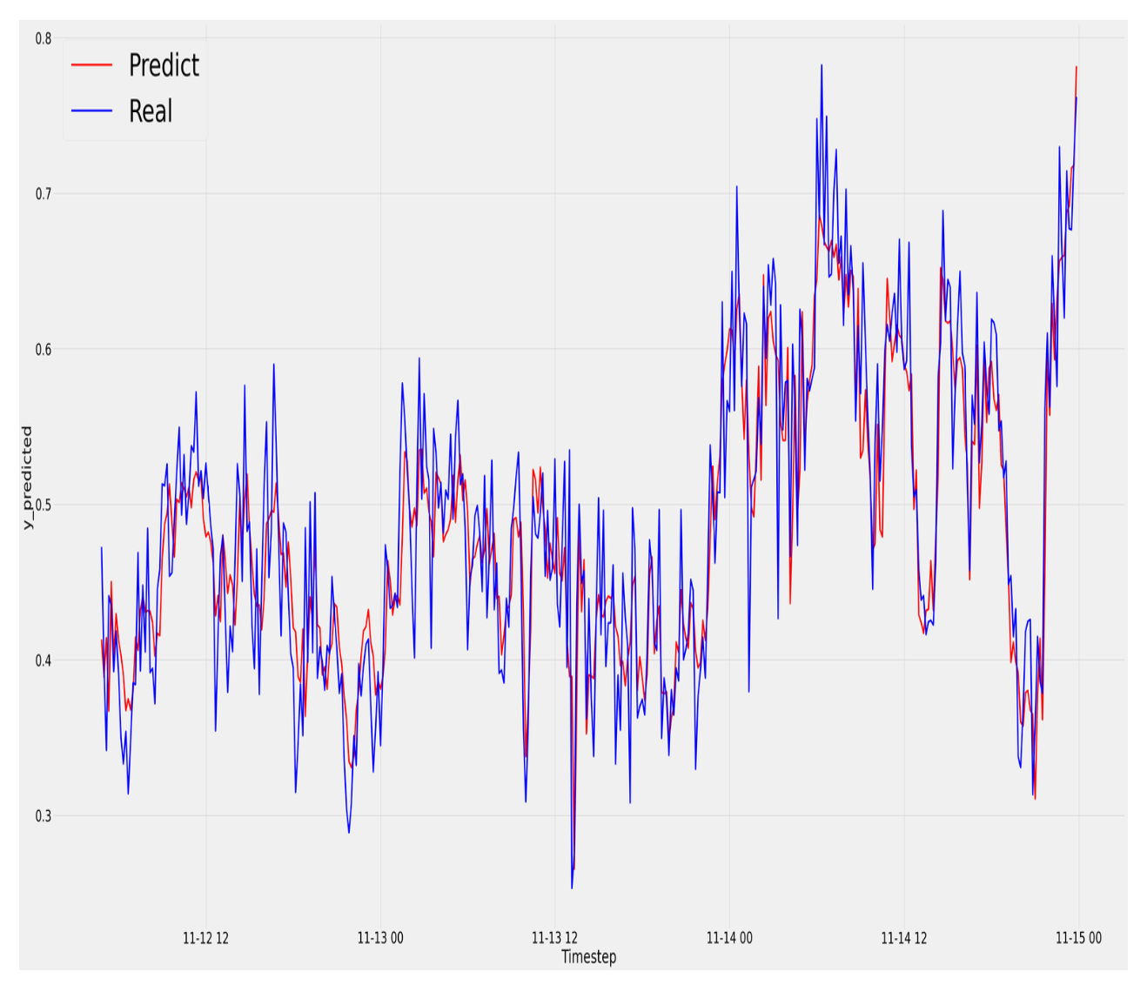
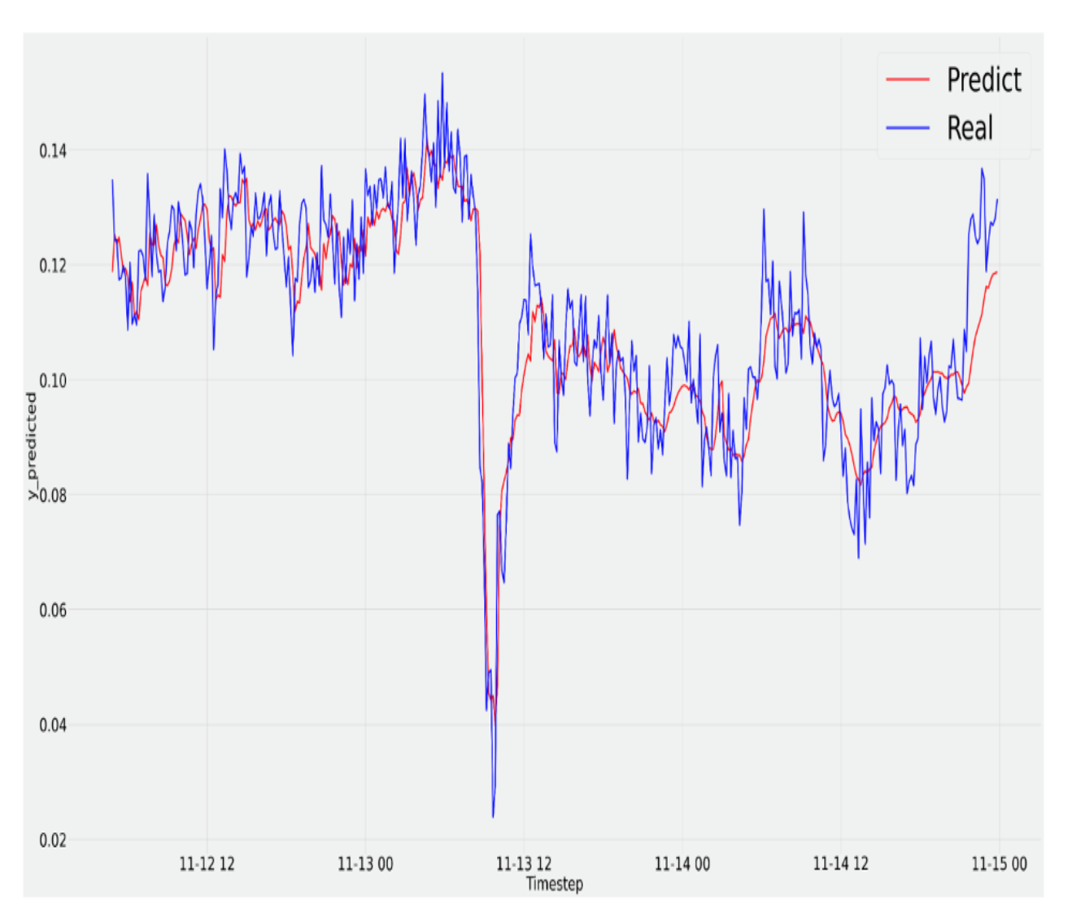
RESULTS
Predicted vs. Real AMP FTIR in the TCM data set.
Predicted vs. Real Piperazine in the TCM data set.
Notes:
Figure 8 plots real values of AMP and values predicted by
LSTM autoencoder with dual-stage attention. Figure 9 plots
the same for Piperazine. The red lines indicate predictions,
whereas the blue lines display actual numbers.
The results indicate that the predicted values of AMP and
Piperazine using our method closely match the actual data. The
proposed model effectively captures fluctuations and patterns
with good precision.

Slide 13
CONCLUSION
Developed LSTM autoencoder with dual-attention for amine emission prediction
Model tested on real emission data shows strong performance:
Error rate: 5.8-6.8%
Outperforms standard LSTM autoencoders
Demonstrates practical potential for carbon capture monitoring applications
Notes:
Slide 10: Conclusion
Summary: "We demonstrated a robust LSTM autoencoder with dual-stage attention for emission prediction, achieving high accuracy and outperforming existing models."
Impact: "Our work shows significant potential for enhancing the operational efficiency of carbon capture systems."
Acknowledgment: "This is a step forward in making carbon capture more effective and sustainable."

Slide 14
FUTURE WORK
Plan to integrate transfer learning techniques to enhance current model.
Goal: Enable model adaptation from TCM data to other carbon capture facilities Expected benefits:
Broader applicability across different emission sources improved predictive robustness in diverse settings
Notes:
Slide 11: Future Work
Plans: "Next, we aim to integrate transfer learning to generalize our model for other facilities, broadening its applicability."
Vision: "This would make predictive models more versatile and impactful across diverse settings."

Slide 15
THANK YOU

